Slide 1

School District of Palm Beach County
SY2016 Final Teacher Evaluation
& Student Performance Reports
Mark Howard, Chief
Performance Accountability
School District of Palm Beach County

Slide 2
FY16 Teacher Evaluations
District Teacher Evaluation Overview
FDOE Value-added Model (VAM)
District Cohort Student Performance Model
Reports and Resources

Slide 3
FY2016 FINAL TEACHER EVALUATIONS
November 28: Teacher Evaluation in PeopleSoft
November 30: Presentation for Teachers, Administrators at Royal Palm Beach High School Auditorium 4:00 – 5:30, 6:00 – 7:30
December 1: Presentation for Teachers, Administrators at Dreyfoos High School
Auditorium 4:00 – 5:30, 6:00 – 7:30
December 2: Increase in pay
December 16: Retroactive pay increase
December 23: Final Evaluations Completed

Slide 4
FY2016 SDPBC J.E.N.C
  Joint Evaluation Negotiating Committee
  Provides review and decisions, when applicable, that impact SDPBC teacher evaluation system.
  CTA Leadership
  Teachers
  Principals
  District Administrators

Slide 5
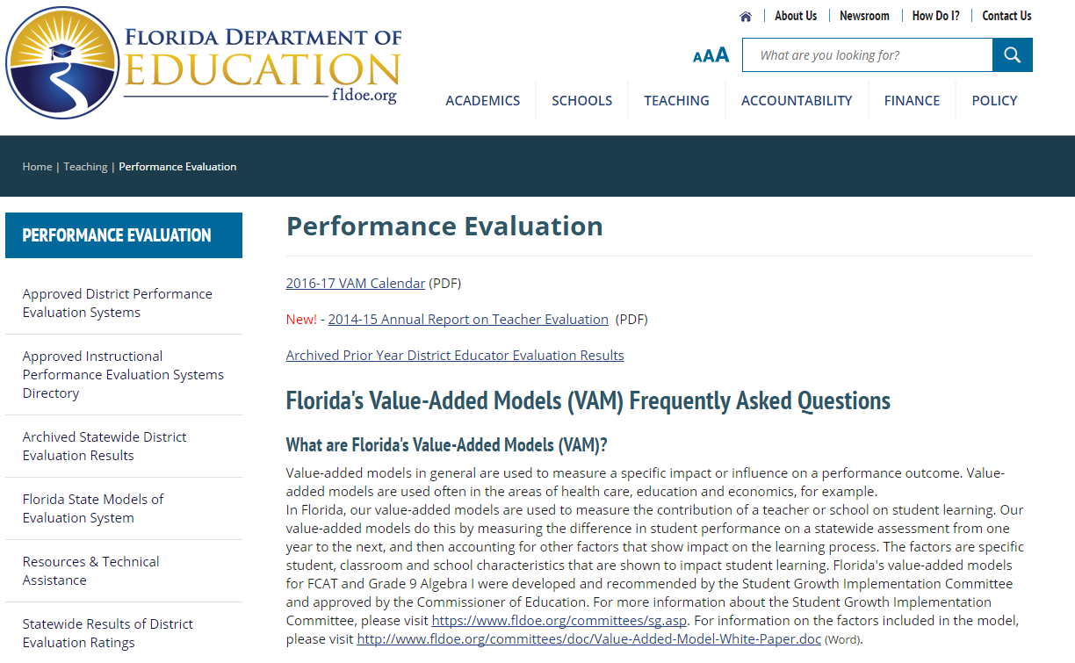
FDOE Educator Evaluations
http://www.fldoe.org/teaching/performance-evaluation/

Slide 6
FY2016 Final Teacher Evaluation Rating Components and Weights
  (IP) Instructional Practice Rating - 57%
  (SP) Student Performance Rating - 33%
  (PG) Professional Growth Rating - 10%
  FINAL EVALUATION RATING - 100%

Slide 7
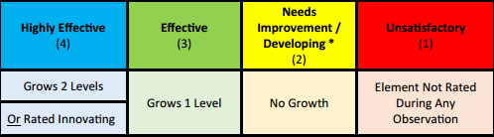
Evaluation Components
(IP) Instructional Practice – 57%
Based on the Palm Beach Model of Instruction
Domain 1: Design Questions 2, 3 or 4
Category 1A: 15 data marks
Category 1B & 2: 10 data marks
(PG) Professional Growth – 10%
Deliberate Practice - Professional Growth Plan

Slide 8
History of Student Performance
Value-added Model (VAM)
FY12 Established by Student Success Act (SB 736)
  Value-added Model (VAM) based on FCAT 2.0 Reading/Math
  School Score for Non-FCAT Teachers
  Teacher and School Administrator Evaluations
    Professional Practice (60%)
    Student Learning Growth (40%)
FY13 Hold Harmless for all components
  Hold Harmless for teachers and administrators
  School Score for Non-FCAT Teachers
FY14 Requires Rating based on Teacher’s Roster
  SDPBC implemented without increasing number of tests
FY15 Districts Determine Component Weights
  SDPBC– IP- 67%, PG – 2%, SP – 33%
FY16 FDOE Determines (VAM only) SP Rating
  Bulletin #P 16-319 DSCOS – State Board Rule 6A-5.0411
  District determines ratings for Local Models
Notes:
Let’s start by reviewing two key elements of the Student Success Act
SGIC included teachers, principals, parents, union representatives, superintendents, school board members, district administrators and postsecondary faculty
Included a school component to the model
The Student Success Act requires the evaluation of instructional personnel and school administrators to consist of two parts: professional practice and student learning growth
Read more at: http://www.flsenate.gov/Committees/BillSummaries/2011/html/0736ED

Slide 9
FY16 Student Performance
State Model / District Cohort Models
State VAM Models | District Cohort Models
4-10 ELA | KG Early Literacy Behaviors
4-8 Math | 1 Palm Beach Performance Assess.
4-8 ELA & Math | 2 District Diagnostic Assessment
8, 9 Algebra 1 | 3 ELA (FSA)
 | 3 Math (FSA)
 | 5, 8 Science (State)
 | Civics, US History, Biology, Algebra 2
 | AP, IB, AICE
 | 11 SAT
 | 11-12 Reading Retakes
Notes:
Let’s start by reviewing two key elements of the Student Success Act
SGIC included teachers, principals, parents, union representatives, superintendents, school board members, district administrators and postsecondary faculty
Included a school component to the model
The Student Success Act requires the evaluation of instructional personnel and school administrators to consist of two parts: professional practice and student learning growth
Read more at: http://www.flsenate.gov/Committees/BillSummaries/2011/html/0736ED

Slide 10
2016 Elementary Tests for
Student Performance Rating
Grade | Cohort or Pre-Test | Ranking or Post-Test
K | Early Literacy Behaviors (1st Trimester) | Early Literacy Behaviors (3rd Trimester)
1 | Early Literacy Behaviors (Prior Year Final) | Palm Beach Performance Assessment
2 | Palm Beach Performance Assessment (Prior Year Final) | District Grade 2 Diagnostic ELA
3 | Palm Beach Performance Assessment (Prior Year Final) | FSA ELA Assessment*
4-5 ELA/ Math | State ELA/Math (VAM variables) | FSA ELA /Math Assessments (State VAM Model)
5 Science | Grade 4 FSA ELA | Grade 5 FCAT 2.0 Science*
Other | State ELA/Math (VAM variables) | Non-FSA VAM
*State mandates the use of this assessment, District determines the model.

Slide 11
2016 Middle School Tests for
Student Performance Rating
Grade | Cohort or Pre-Test | Ranking or Post-Test
6-8: ELA/ Math | State ELA/Math (VAM variables) | FSA EAL/Math Assessments (State VAM Model)
7: Civics | Grade 6 FSA ELA | Civics EOC Exam*
8: Science | Grade 7 FSA ELA | Grade 8 FCAT 2.0 Science*
8: Algebra | State Test (VAM variables) | Algebra EOC Exam (State VAM Model)
Geometry | Prior Math | Geometry EOC Exam
Other | Prior FSA | Non-FSA VAM
*State mandates the use of this assessment, District determines the model.

Slide 12
2016 High School Tests for
Student Performance Rating
Grade | Cohort or Pre-Test | Ranking or Post-Test
9-10: ELA | State Test (VAM variables) | FSA ELA Assessments (State VAM Model)
9: Algebra | State Test (VAM variables) | Algebra EOC Exam (State VAM Model)
Geometry | Prior EOC Math Assessment | Geometry EOC Exam*
Algebra 2 | Prior EOC Math Assessment | Algebra 2 EOC Exam*
Biology | Prior FSA ELA Assessment | Biology EOC Exam*
US History | Prior FSA ELA Assessment | US History EOC Exam*
AP, AICE, IB | Aligned Prior FSA Assessment | AP, AICE, or IB Exam
11-12: Reading | Prior FSA ELA Assessment | Meeting Grad Requirement (FCAT, FSA, ACT, SAT)
11 (no other models apply) | Grade 10 FSA ELA Assessment | Combined SAT Score
Other | Prior FSA | Non-FSA VAM
*State mandates the use of this assessment, District determines the model.

Slide 13
FDOE Value-added Model (VAM)

Slide 14
FDOE Value-added Model (VAM)
Florida Rule 6A-5.0411
Begins School Year 2015-16
Teach VAM Courses ELA, Math, Algebra 1
-ELA Grade 4-10
-Math Grade 4-8
-Algebra 1 Grade 8 or 9
State Assigns Student Performance Rating

Slide 15

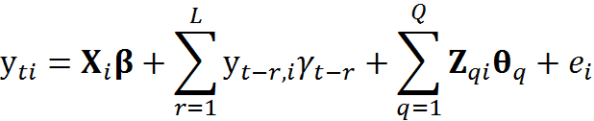
FDOE Value-added Model (VAM)
Contribution to a change in a student’s achievement on standardized test
Calculated from a statistical measure of student learning growth
http://www.fldoe.org/committees/sg.asp

Slide 16
What is the
VAM Score?
The difference between
Current score and
Expected score
What is the
Expected Score?
Notes:
In other words, in order to determine a student’s growth score, it is necessary to know a student’s current and predicted score.
The current score is simply the score a student received.
So what is a student’s predicted score ?

Slide 17
What is the
Expected Student Score?
Score expected
based on prior tests and
other characteristics

Slide 18
FLDOE Value-Added Model
Variables determining expected score
Two or more years of prior scores
Gifted status
Class size
Student Attendance (Days)
Mobility (number of transitions)
Difference from modal age in grade
(indicator of retention)
Number of subject-relevant courses enrolled
Homogeneity of entering test scores in the class
http://www.fldoe.org/committees/sg.asp
Notes:
The other information was determined by the SGIC. It includes a variety of selected student and class characteristics, including student attendance, mobility, and class size.

Slide 19


FLDOE Value-Added Model
Variables determining expected score
Students with Disabilities (SWD) status
  Language impaired
  Hearing impaired
  Visually impaired
  Emotional/behavioral
  Specific learning disability
  Dual sensory impaired
  Autism spectrum disorder
  Traumatic brain injury
  Other health impaired
  Intellectual disability
English Language Learner (ELL) status
  LY
http://www.fldoe.org/committees/sg.asp
Notes:
The student characteristics also include SWD status and ELL status.

Slide 20
What is the
VAM Score?
Let’s take a look at
the expected score
Notes:
So know that we know a student’s current score and predicted score, we can calculate a student’s learning growth score
It is simply the difference between the predicted and current score.
Let’s work through some examples of how this works.

Slide 21
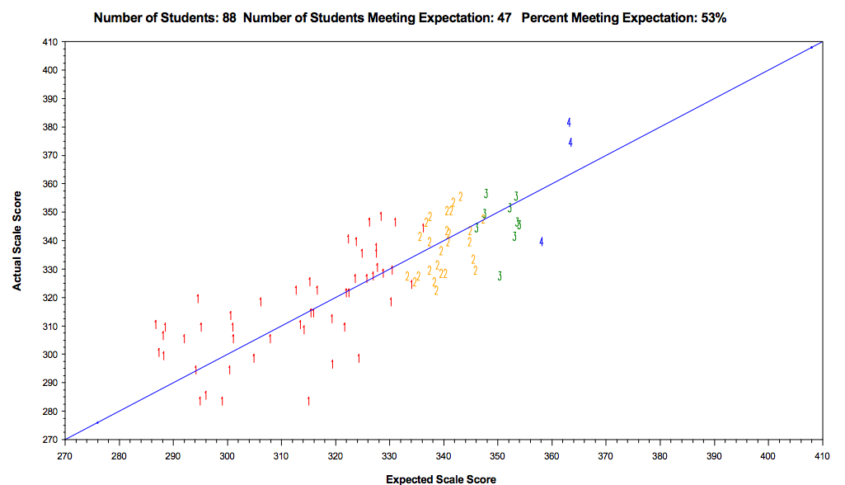
WHAT IS THE “EXPECTED” SCORE”
ACTUAL SCORE
EXPECTED SCORE

Slide 22
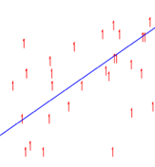

WHAT IS THE “SCORE”
The difference between the expected and actual scores is the growth.
The average of the growth of students assigned produces the score for a teacher.

Slide 23
What are Confidence Intervals
Express the level of confidence that if repeated, score would repeat within same range
Factors may affect the confidence interval
  size of sample (number of students)
  population variability (range of scores)
A larger sample normally leads to a better estimate
WHAT ARE
CONFIDENCE INTERVALS?
Florida Rule 6A-5.0411

Slide 24
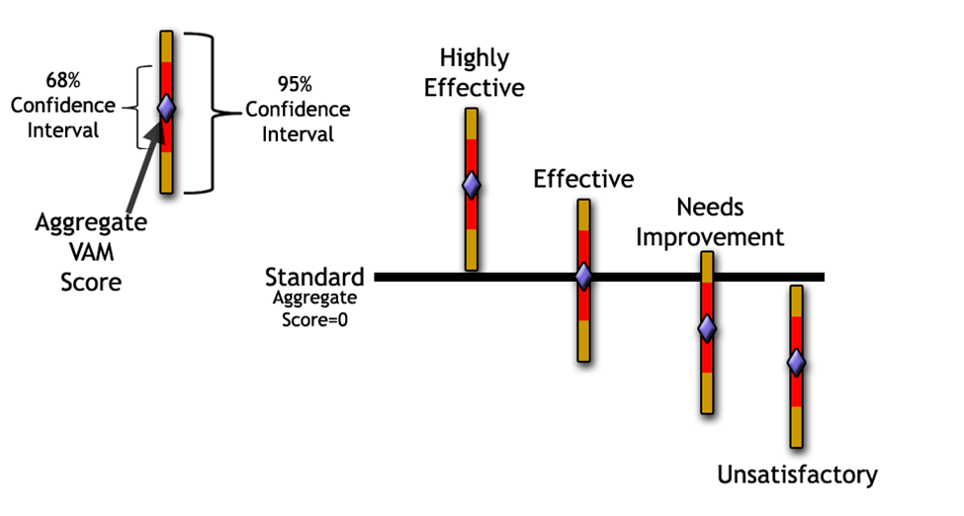
State VAM model uses confidence intervals to determine Student Performance Ratings.
WHAT ARE
CONFIDENCE INTERVALS?
Florida Rule 6A-5.0411

Slide 25
State VAM model uses confidence intervals to determine Student Performance Ratings.
Florida Rule 6A-5.0411

Slide 26
Florida’s VAM Rule Examples
Tchr | Student Performance Rating | # of Stu | VAM Score | 95% Confidence Interval (Lower Limit) | 95% Confidence Interval (Upper Limit) | 68% Confidence Interval (Lower Limit) | 68% Confidence Interval (Upper Limit)
A | Highly Effective | 124 | 0.22 | 0.10 | 0.34 | 0.16 | 0.28
B | Effective | 184 | -0.07 | -0.37 | 0.23 | -0.22 | 0.08
C | Needs Improvement | 56 | -0.49 | -1.19 | 0.21 | -0.84 | -0.14
D | Unsatisfactory | 99 | -0.69 | -1.03 | -0.35 | -0.86 | -0.52
Highly Effective: Both 68% and 95% Confidence Intervals are above 0.
Effective: 3 possible scenarios: (1) VAM Score of 0; (2) VAM Score above 0, where some portion of the scores associated with a 95% Confidence Interval lies at or below 0; or (3) VAM Score less than 0, where some portion of the scores associated with both the 68% and the 95% Confidence Interval lies at or above 0.
Needs Improvement: VAM Score is less than 0, the entire 68% Confidence Interval falls below 0, but a portion of the 95% Confidence Interval lies above 0.
Unsatisfactory: Both 68% and 95% Confidence Intervals are below 0.
Employee evaluations DEPARTMENT

Slide 27
State Value-added Model (VAM)
Grades 4-10 ELA, Grades 4-8 Math, Grade 8 & 9 Algebra 1
Unsatisfactory
Both 68% and 95% Confidence Intervals are below 0.
Highly Effective
Both 68% and 95% Confidence Intervals are above 0.

Slide 28
State Value-added Model (VAM)
Grades 4-10 ELA, Grades 4-8 Math, Grade 8 & 9 Algebra 1
Needs
Improvement
Effective
VAM Score is less than 0, entire 68% Confidence Interval falls below 0, but a portion of the 95% Confidence Interval lies above 0
(1) VAM Score of 0; (2) VAM Score above 0, where some portion of the scores associated with a 95% Confidence Interval lies at or below 0; or (3) VAM Score less than 0, where some portion of the scores associated with both the 68% and the 95% Confidence Interval lies at or above 0.

Slide 29
District Cohort Model

Slide 30
District Cohort Model
Cohorts: based on Average Prior Year Performance of Students Assigned
Rank: based on Average Current Performance of Students Assigned
 | 1) Cohort based on Average Prior Year Performance
 | Low | Low- Moderate | High- Moderate | High
2) Rank based on Average Current Year Performance | 83%+ | 83%+ | 83%+ | 83%+
 |  |  | 14-83% | 14-83%
 |  | 14-83%
 | 14-83%
 | 6-14% |  |  | 0-6%
 |  | 0-6%
 | 0-6%
RANK
RANK
RANK
RANK
6-14%
6-14%
6-14%
0-6%

Slide 31
Cohort Assignment

Slide 32
FY16 Student Performance District Model
 | District Local Models
Cohort | KG Early Literacy Behaviors
Cohort | 1 Palm Beach Performance Assess.
Cohort | 2 District Diagnostic Assessment
Cohort | 3 Reading (FSA)
Cohort | 3 Math (FSA)
Cohort | 5, 8 Science (State)
Cohort | Civics, US History, Biology, Algebra 2
Cohort | AP, IB, AICE
Cohort | 11 SAT
Cohort | 11-12 Reading Retakes

Slide 33
2016 Elementary Tests for
Student Performance Rating
Grade | Cohort Test | Ranking Test
K | Early Literacy Behaviors (1st Trimester) | Early Literacy Behaviors (3rd Trimester)
1 | Early Literacy Behaviors (Prior Year Final) | Palm Beach Performance Assessment
2 | Palm Beach Performance Assessment (Prior Year Final) | District Grade 2 Diagnostic ELA
3 | Palm Beach Performance Assessment (Prior Year Final) | FSA ELA Assessment*
5 Science | Grade 4 FSA ELA | Grade 5 FCAT 2.0 Science*
*State mandates the use of this assessment, District determines the model.

Slide 34
2016 Middle School Tests for
Student Performance Rating
Grade | Cohort Test | Ranking Test
7: Civics | Grade 6 FSA ELA | Civics EOC Exam*
8: Science | Grade 7 FSA ELA | Grade 8 FCAT 2.0 Science*
Geometry | Prior Math | Geometry EOC Exam
*State mandates the use of this assessment, District determines the model.

Slide 35
2016 High School Tests for
Student Performance Rating
Grade | Cohort Test | Ranking Test
Geometry | Prior EOC Math Assessment | Geometry EOC Exam*
Algebra 2 | Prior EOC Math Assessment | Algebra 2 EOC Exam*
Biology | Prior FSA ELA Assessment | Biology EOC Exam*
US History | Prior FSA ELA Assessment | US History EOC Exam*
AP, AICE, IB | Aligned Prior FSA Assessment | AP, AICE, or IB Exam
11-12: Reading | Prior FSA ELA Assessment | Meeting Grad Requirement (FCAT, FSA, ACT, SAT)
11 (no other models apply) | Grade 10 FSA ELA Assessment | Combined SAT Score
*State mandates the use of this assessment, District determines the model.

Slide 36
Average Achievement Of Students
 | STU | Teacher 1 | Teacher 2 | Teacher 3 | Teacher 4
Achievement Levels | 1 | 1 | 2 | 3 | 5
 | 2 | 2 | 2 | 3 | 5
 | 3 | 2 | 2 | 3 | 5
 | 4 | 1 | 1 | 2 | 3
 | 5 | 1 | 2 | 3 | 5
 | 6 | 2 | 2 | 3 | 3
 | 7 | 1 | 2 | 3 | 5
 | 8 | 2 | 2 | 3 | 5
 | 9 | 2 | 2 | 4 | 3
 | 10 | 2 | 2 | 3 | 5
 | 11 | 1 | 3 | 5 | 4
 | 12 | 1 | 3 | 5 | 4
 | 13 | 1 | 2 | 3 | 4
 | 14 | 1 | 3 | 5 | 5
 | 15 | 2 | 2 | 3 | 5
 | 16 | 2 | 1 | 2 | 4
 | 17 | 1 | 1 | 2 | 3
 | 18 | 2 | 2 | 3 | 5
 | 19 | 2 | 2 | 3 | 5
 | 20 | 1 | 2 | 3 | 5
 | Avg. | 1.50 | 2.00 | 3.24 | 4.53

Slide 37
Grade 1: Palm Beach Performance Assessment (PBPA)
Number of Points | Scaled Score
1 – 6 | 1
7 – 10 | 2
11 – 14 | 3
15 – 18 | 4*
19 – 21 | 5
22 - 24 | 6
*End of Year Proficiency: Level 4

Slide 38
Kindergarten: Elementary Literacy Behavior
October | February | May
Oral Language 1 = 2 or below 2 = 3 – 4 3 = 5 – 6 4 = 7 – 9 | Oral Language 1 = 3 – 4 2 = 5 – 6 3 = 7 – 9 4 = 10+ | Oral Language 1 = 5 – 6 2 = 7 – 9 3 = 10 4 = 11+
Concepts of Print 1 = 1 2 = 2 – 3 3 = 4 – 5 4 = 6+ | Concepts of Print 1 = 5 or below 2 = 6 – 7 3 = 8 – 9 4 = 10 | Concepts of Print 1 = 7 2 = 8 – 9 3 = 10 4 = 10 Prior May
Combined Letter ID 1 = 6 or below 2 = 7 – 14 3 = 15 – 20 4 = 20+ | Combined Letter ID 1 = 14 – 17 2 = 18 – 34 3 = 35 – 45 4 = 46+ | Combined Letter ID 1 = 18 – 34 2 = 35 – 45 3 = 46 – 50 4 = 51 – 52
Letter Sound 1 = 4 or below 2 = 5 – 8 3 = 9 – 13 4 = 14+ | Letter Sound 1 = 5 – 8 2 = 9 – 13 3 = 14 – 16 4 = 17+ | Letter Sound 1 = 9 – 13 2 = 14 – 16 3 = 17 – 18 4 = 19
Word List 1 = 8 or below 2 = 9 – 14 3 = 15 – 25 4 = 26 – 60 | Word List 1 = 9 – 24 2 = 25 – 35 3 = 36 – 60 4 = 61 – 75 | Word List 1 = 25 – 35 2 = 36 – 60 3 = 61 – 75 4 = 76+
Notes:
Cohort ELB – Cohort determined by a teacher’s students average Trimester 1 scores across the five skill areas. Next, to determine growth for a student, growth on all five skills must be met (Y) before or during Tri 3. Teachers are then ranked within the Cohort based on the percentage of students with growth (Y).

Slide 39
Cohort Rank

Slide 40
How are Cohort Model Teachers Ranked?
State VAM Rating | State VAM % of Teachers | Ranks for District Cohort Model
Highly Effective | 17% | 83.1% or Higher
Effective | 69% | 14.1% to 83%
Needs Improvement | 8% | 6.1% to 14%
Unsatisfactory | 6% | 6%
Cohort Rating Scale Developed by J.E.N.C. to ensure equity.

Slide 41
Cohort Model
 | Teacher Cohorts based on Average Prior Year Performance
 | Low | Low- Moderate | High- Moderate | High
Teacher Rank based on Average Current Performance | 83%+ | 83%+ | 83%+ | 83%+
 |  |  | 14-83% | 14-83%
 |  | 14-83%
 | 14-83%
 | 6-14% |  |  | 0-6%
 |  | 0-6%
 | 0-6%
6-14%
6-14%
6-14%
0-6%

Slide 42
Illustration of Cohort Model:
Grade 5 Science
 | Teacher Cohorts based on Average Prior Year Performance
 | Low | Low- Moderate | High- Moderate | High
Teacher Rank based on Average Current Performance | 83%+ | 83%+ | 83%+ | 83%+
 |  |  | 14-83% | 14-83%
 |  | 14-83%
 | 14-83%
 | 6-14% |  |  | 0-6%
 |  | 0-6%
 | 0-6%
4.8
4.1
2.9
1.0
Rank Avg. Achievement Level
6-14%
6-14%
6-14%
0-6%
Notes:
Illustrates equity among cohorts

Slide 43
Illustration of Cohort Model:
Grade 8 Science
 | Teacher Cohorts based on Average Prior Year Performance
 | Low | Low- Moderate | High- Moderate | High
Teacher Rank based on Average Current Performance | 83%+ | 83%+ | 83%+ | 83%+
 |  |  | 14-83% | 14-83%
 |  | 14-83%
 | 14-83%
 | 6-14% |  |  | 0-6%
 |  | 0-6%
 | 0-6%
4.8
4.1
2.9
1.0
Rank Avg. Achievement Level
6-14%
6-14%
6-14%
0-6%

Slide 44
Illustration of Cohort Model:
U.S. History EOC
 | Teacher Cohorts based on Average Prior Year Performance
 | Low | Low- Moderate | High- Moderate | High
Teacher Rank based on Average Current Performance | 83%+ | 83%+ | 83%+ | 83%+
 |  |  | 14-83% | 14-83%
 |  | 14-83%
 | 14-83%
 | 6-14% |  |  | 0-6%
 |  | 0-6%
 | 0-6%
4.8
4.1
2.9
1.0
Rank Avg. Achievement Level
6-14%
6-14%
6-14%
0-6%

Slide 45
AP/AICE/IB Model:
  Teachers grouped into 3 cohorts
  Teachers ranked based on the difference between their pass rate and the district pass rate
  Teachers with 100% pass rate- Highly Effective

Slide 46
Illustration of Cohort Model:
AP/IB/AICE
 | Teacher Cohorts based on Average Prior Year Performance
 | Moderate | High- Moderate | High
Teacher Rank based on Average Current Performance | 83%+ | 83%+ | 83%+
 |  | 14-83% | 14-83%
 | 14-83%
 |  |  | 0-6%
 | 0-6%
82.3
71.5
69.1
43.7
District Pass Rate 60%
6-14%
6-14%
6-14%
0-6%

Slide 47
Illustration of Cohort Model:
AP/IB/AICE
 | Teacher Cohorts based on Average Prior Year Performance
 | Moderate | High- Moderate | High
Teacher Rank based on Average Current Performance | 83%+ | 83%+ | 83%+
 |  | 14-83% | 14-83%
 | 14-83%
 |  |  | 0-6%
 | 0-6%
22.3
11.5
9.1
-16.3
District Pass Rate 60%
Ranked Differences
6-14%
6-14%
6-14%
0-6%

Slide 48
Non-FSA VAM

Slide 49
Non-FSA VAM:
  Teachers rated based on percent of students who met or exceeded their expected score from the State VAM model.
State VAM Rating | Ranks for District Local Models
Highly Effective | 83.1% or Higher
Effective | 14.1% to 83%
Needs Improvement | 6.1% to 14%
Unsatisfactory | 6%

Slide 50
Combining Student Performance Ratings
Teachers have multiple score types

Slide 51
Teachers with Multiple Models
Combining Ratings
Student Performance Score Rating - Combining Models
 | Rating 1 | Rating 2 | Rating 3 | Average | Final Rating
Teacher 1 | Effective (3) | Effective (3) | Unsatisfactory (1) | 7/3 = 2.3 | Needs Improvement
Teacher 3 | Highly Effective (4) | Effective (3) |  | 7/2 = 3.5 | Highly Effective
Student Performance Score Ratings | Average
Highly Effective (4) | 3.5 – 4.0
Effective (3) | 2.5 - 3.4
Needs Improvement/Dev (2) | 1.5 - 2.4
Unsatisfactory (1) | 1.0 -1.4
Notes:
HS Math Teacher with Algebra 1 ninth, Geometry EOC and the Algebra 2 EOC.

Slide 52
Final Evaluation Rating Scale

Slide 53
FY16 Final Evaluation Ratings
HE | E | NI/Dev | U
3.2-4.0 | 2.1-3.1 | 1.2-2.0 | 1.0-1.1
Inst. Practice (57%) | Student Performance (33%) | Deliberate Practice (10%) | Overall Score
4 | 4 | 4 | 4.0
4 | 4 | 3 | 3.9
4 | 4 | 2 | 3.8
4 | 4 | 1 | 3.7
4 | 3 | 4 | 3.7
4 | 3 | 3 | 3.6
4 | 3 | 2 | 3.5
4 | 3 | 1 | 3.4
4 | 2 | 4 | 3.3
4 | 2 | 3 | 3.2
4 | 2 | 2 | 3.1
4 | 2 | 1 | 3.0
4 | 1 | 4 | 3.0
4 | 1 | 3 | 2.9
4 | 1 | 2 | 2.8
4 | 1 | 1 | 2.7
3 | 4 | 4 | 3.4
3 | 4 | 3 | 3.3
3 | 4 | 2 | 3.2
3 | 4 | 1 | 3.1
3 | 3 | 4 | 3.1
3 | 3 | 3 | 3.0
3 | 3 | 2 | 2.9
3 | 3 | 1 | 2.8
3 | 2 | 4 | 2.8
3 | 2 | 3 | 2.7
3 | 2 | 2 | 2.6
3 | 2 | 1 | 2.5
3 | 1 | 4 | 2.4
3 | 1 | 3 | 2.3
3 | 1 | 2 | 2.2
3 | 1 | 1 | 2.1
Inst. Practice (57%) | Student Performance (33%) | Deliberate Practice (10%) | Overall Score
2 | 4 | 4 | 2.9
2 | 4 | 3 | 2.8
2 | 4 | 2 | 2.7
2 | 4 | 1 | 2.6
2 | 3 | 4 | 2.5
2 | 3 | 3 | 2.4
2 | 3 | 2 | 2.3
2 | 3 | 1 | 2.2
2 | 2 | 4 | 2.2
2 | 2 | 3 | 2.1
2 | 2 | 2 | 2.0
2 | 2 | 1 | 1.9
2 | 1 | 4 | 1.9
2 | 1 | 3 | 1.8
2 | 1 | 2 | 1.7
2 | 1 | 1 | 1.6
1 | 4 | 4 | 2.3
1 | 4 | 3 | 2.2
1 | 4 | 2 | 2.1
1 | 4 | 1 | 2.0
1 | 3 | 4 | 2.0
1 | 3 | 3 | 1.9
1 | 3 | 2 | 1.8
1 | 3 | 1 | 1.7
1 | 2 | 4 | 1.6
1 | 2 | 3 | 1.5
1 | 2 | 2 | 1.4
1 | 2 | 1 | 1.3
1 | 1 | 4 | 1.3
1 | 1 | 3 | 1.2
1 | 1 | 2 | 1.1
1 | 1 | 1 | 1.0

Slide 54
Reports & Resources

Slide 55
Principal Resource Center:
Teacher Reports
Teacher reports available in Principal Resource Center
at school site of FY16 evaluation. Reports provided are:
Teacher Evaluation Letter also posted on PeopleSoft
Teacher Rosters for each Model that applies
Percent meeting expectations Level Graphs & Rosters to facilitate data chats (non-evaluative)

Slide 56
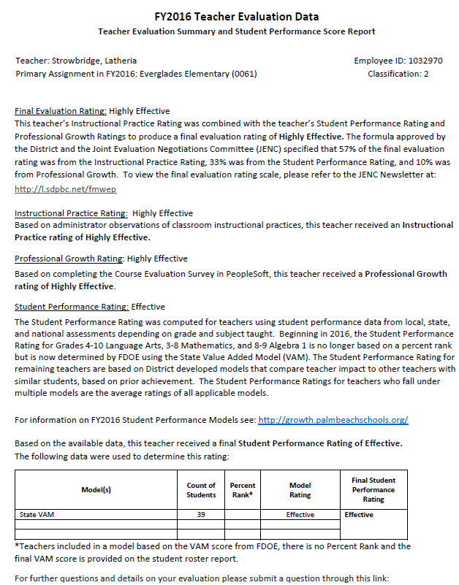
PeopleSoft Self-Serve

Slide 57
Sample Rating Tables from Teacher Letter
Single Cohort Model
Single Assigned
VAM Model
Combo Models
School VAM Score

Slide 58
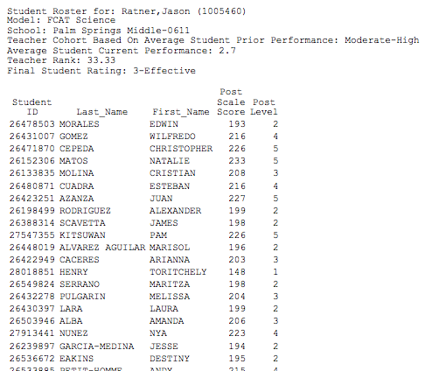
Cohort Model Teacher Rosters (MS)

Slide 59
Level Graphs

Slide 60
RESOURCES AND SUPPORT
FDOE Performance Evaluation
http://www.fldoe.org/teaching/performance-evaluation/
FDOE Student Growth
http://www.fldoe.org/teaching/performance-evaluation/student-growth.stml
Professional Development – Teacher Evaluation
https://www.palmbeachschools.org/staffdev/teacherevaluation/
Deliberate Practice
https://www.palmbeachschools.org/staffdev/deliberatepractice/
JENC Newsletter
https://www.palmbeachschools.org/staffdev/jenc/
Research & Evaluation – Student Performance Resources
https://growth.palmbeachschools.org/

